Slide 1
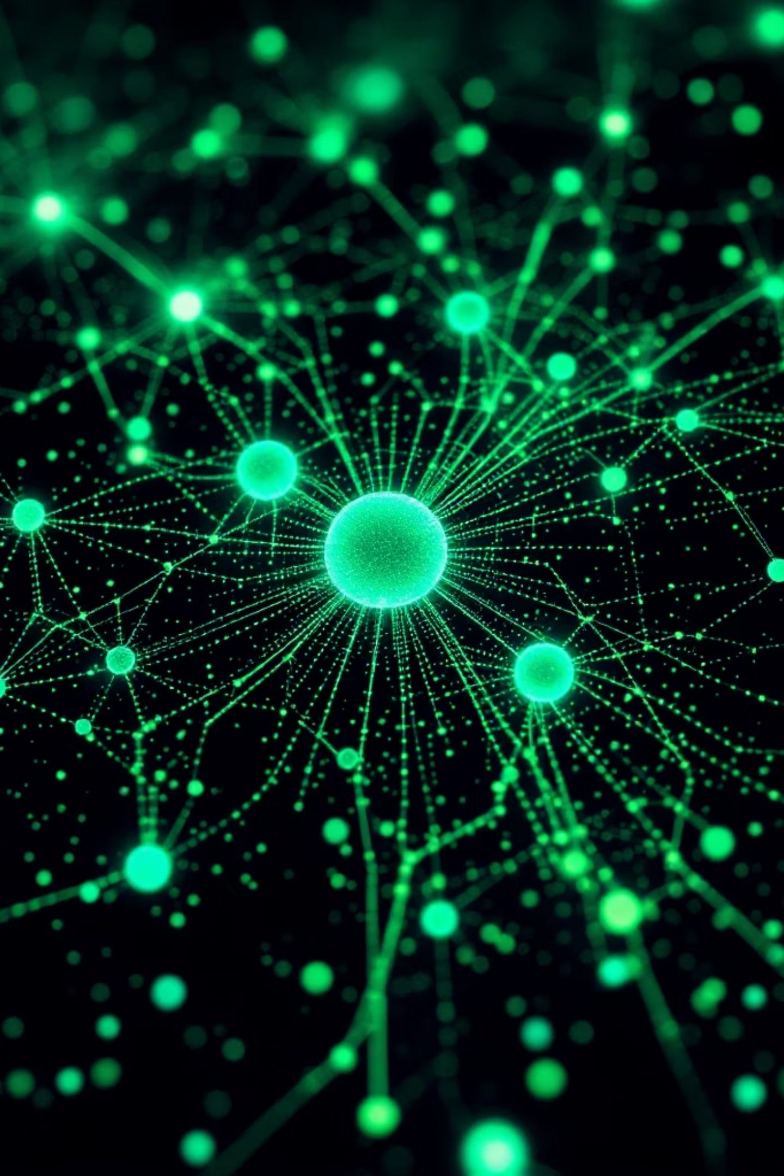
Understanding Stable Diffusion Assignment 5
Muskan : 28
Yashashree Nimbalkar : 40
GENERATIVE AI
DEEP LEARNING

Slide 2
What Are Diffusion Models?
The core concept behind a new generation of AI image synthesis.
Inspired by Physics
Forward Process
Reverse Process
Diffusion models are inspired by the physical process of diffusion — starting from pure noise, the model learns to reverse the process step-by-step, recreating a coherent data distribution.
During training, noise is progressively added to real images across many timesteps until only Gaussian noise remains.
At inference, the model iteratively denoises a random noise tensor, guided by learned patterns, to produce a detailed, realistic image.

Slide 3
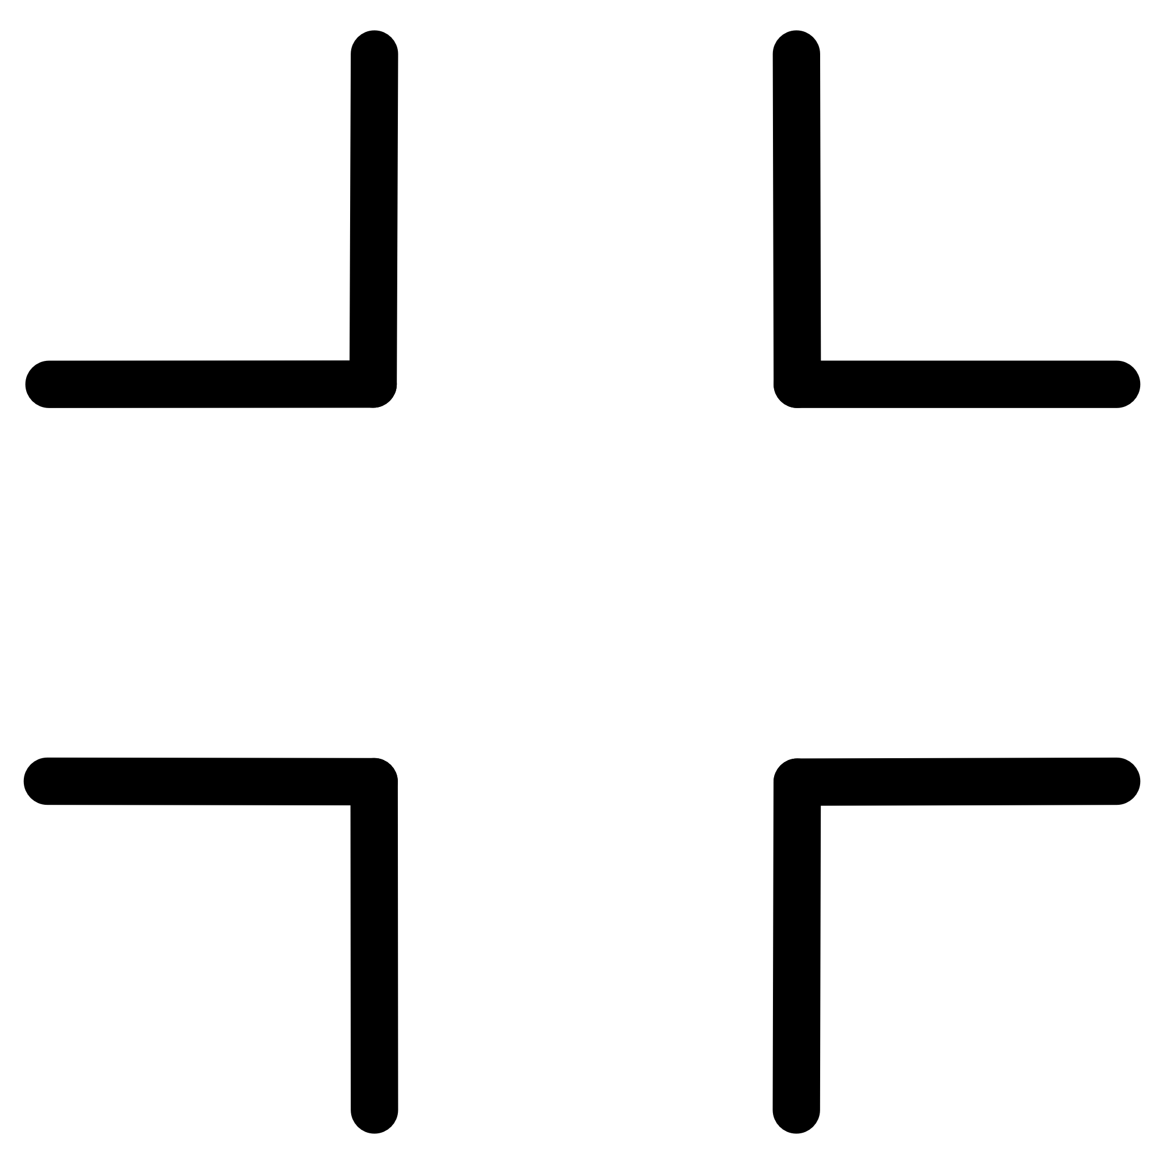
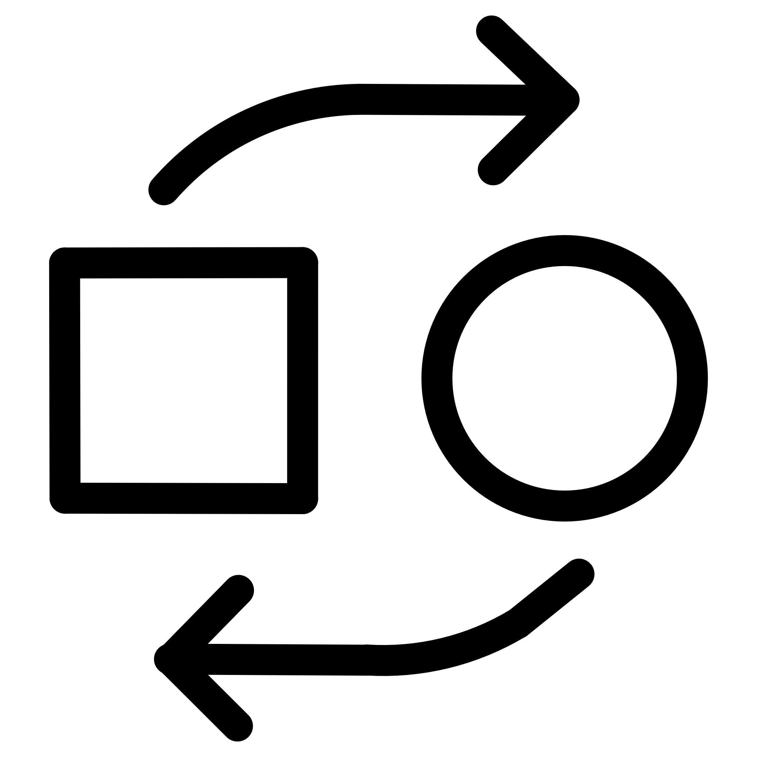

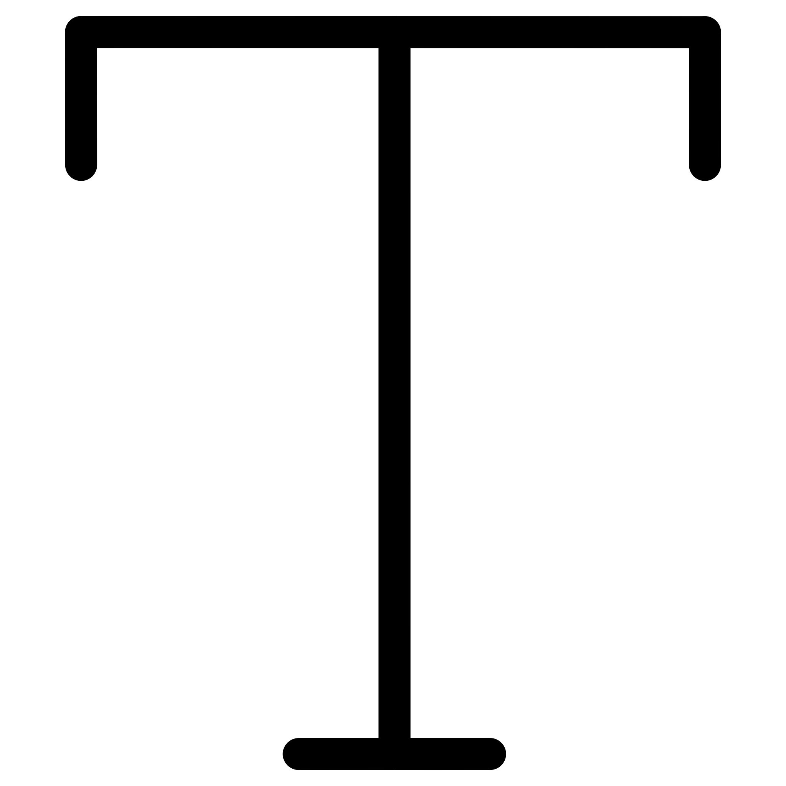

Stable Diffusion Architecture
Five tightly integrated components work in concert to enable fast, high-fidelity image generation.
Latent Space Diffusion
Variational Autoencoder
U-Net Backbone
The core denoising network predicts and removes noise at each timestep, conditioned on text embeddings from the encoder.
Operates on compressed latent representations rather than full-resolution pixels — drastically reducing memory and compute requirements.
The VAE encodes input images into a low-dimensional latent space and decodes generated latents back into high-resolution images.
Text Encoder
Cross-Attention
A Transformer-based encoder (e.g. CLIP) converts text prompts into rich embedding vectors that steer the generation process.
Cross-attention layers fuse text embeddings with image features inside the U-Net, enabling precise, nuanced control over output content.
Complete Flow: Text Prompt → CLIP → Text Embedding → Noise → ​ U Net ​(Guided by text) → Latent Image → VAE decoder → Final Image

Slide 4

Uses, Advantages & What Sets It Apart
Key Applications
Why Stable Diffusion Stands Out
Text-to-Image Synthesis
High Fidelity
Efficient
Generate photorealistic or artistic images from natural language prompts.
Photorealistic images with exceptional fine detail.
Latent-space operation enables consumer-grade hardware use.
Inpainting & Editing
Seamlessly edit regions of existing images guided by text or masks.
Open Source
Controllable
Freely available, fostering innovation and deep customisation.
Strong text conditioning allows nuanced, steerable outputs.
Style Transfer & Creative Work
Apply artistic styles, create concept art, and power creative workflows.

